Slide 1
Rhapsody and Qt Integration
How to use the QTProfile – version 0.4.1
Giulio Santoli
IBM Software, Rational
14 June 2012

Slide 2
Table of contents
Introduction and Limitations
Setup and Configuration
QTProfile Stereotypes
Usage Overview
Hello World Example
Signals & Slots Example
Synchronous Example: Simple Countdown
Asynchronous Example: Simple Countdown

Slide 3
Introduction and Limitations
This is a sample profile for Rhapsody C++ and Qt integration.
It allows you to develop Qt-compatible code that also takes advantage of Rhapsody capabilities, such as state-machines with either synchronous or asynchronous events.
The profile automatically generates the Qt project file and customize it accordingly.
The current implementation supports the following:
  Qt 4.7.3 for Windows (VS 2008 only) and Linux, with and without Animation (no Tracing).
  All the .ui files can be stored in the “gui” directory in the Rhapsody project or imported in the model.
  No support for Qt message catalogs and resources yet.
  Only Qt Core and GUI classes are included and they are not 100% complete.
  All the slots are public, regardless their visibility in the model.

Slide 4
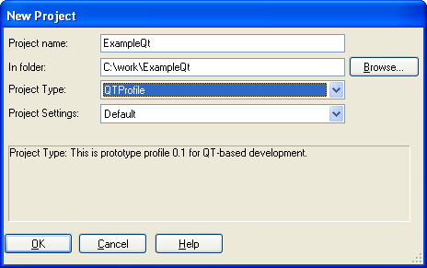
Setup and Configuration
Ensure that Qt binaries (i.e. qmake) are in the PATH of your environment.
Copy the QTProfile profile in the default profile directory (OMROOT\Profiles). This is a once only step.
Add the QTProfile profile to your project or create a new project using it.
Optionally, create the gui directory in your project and put all the QT user interface files (.ui) in it.

Slide 5
QTProfile Stereotypes
<<QTObject>>
  You can use this stereotype to flag those Classes that needs to be Qt-compliant, with the Q_OBJECT macro, signals and slots.
  <<QTSignal>>
  You can use this stereotype to flag those Operations that are Qt Signals. They will be declared in the specification file (.h). Use it only for operations belonging to classes stereotyped as <<QTObject>>.
  <<QTSlot>>
  You can use this stereotype to flag those Operations, Triggered Operations or Receptions that are Qt Slots. Use it only for operations belonging to classes stereotyped as <<QTObject>>.
  <<QTConfiguration>>
  You can use this stereotype to flag those Configurations that you want to generate Qt-related programs. The default Makefile and Main are generated accordingly.

Slide 6
Usage Overview
To create you classes and set the <<QTObject>> stereotype to those of them you want to be Qt-enabled.
When you stereotype a class with <<QTObject>> do the following:
  Create a generalization dependency to the proper Qt class provided in the profile. If you want to generalize a different class, copy one of the above ones in your project and rename at your will.
  Create a constructor that initializes the parent Qt class, i.e. MyWindget(QWidget* parent)
  Create the <<Usage>> dependency with any other Qt class you want to include.
  Apply the <<QTSignal>> and <<QTSlot>> stereotypes accordingly.
Apply the <<QTConfiguration>> stereotype to the Rhapsdody configuration you want to generate the Qt-enabled program.
If you need user interface files (.ui) generated with Qt Designer, you can either:
  import them into the model as <<QTUIFile>> then generate the corresponding class
  put them in the “gui” directory in your project and manually include their correspondent header file names, as they are supposed to be generated during the QT buil process.

Slide 7

Testing the Environment: “Hello World”

Slide 8
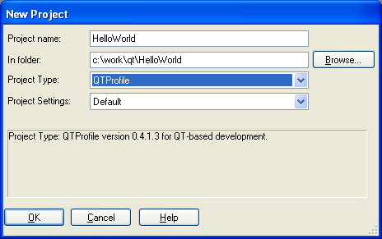
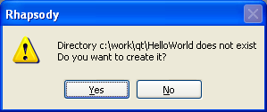
Create the HelloWorld Project
Create a new project called HelloWorld and add specify the QTProfile project type:
Answer Yes to the following question:

Slide 9
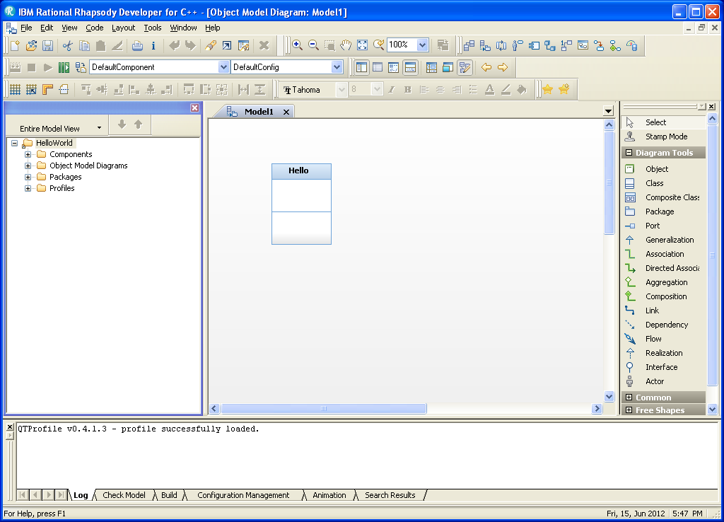
Create the Hello Class
Create the Hello class in the default Object Model Diagram

Slide 10
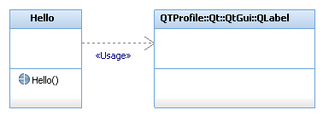
Create Usage Dependency to QLabel
To use the QLabel class of the Qt GUI framework, crate a dependency relationship from the Hello class to QLabel and apply the <<Usage>> stereotype to this dependency:
Thanks to this dependency, Rhapsody adds the right include statement in the generated code.
Instead of using a dependency relationship you can either specify <QLabel> in the property CPP_CG::Class::ImpIncludes or CPP_CG::Class::SpecIncludes of the Hello class.

Slide 11
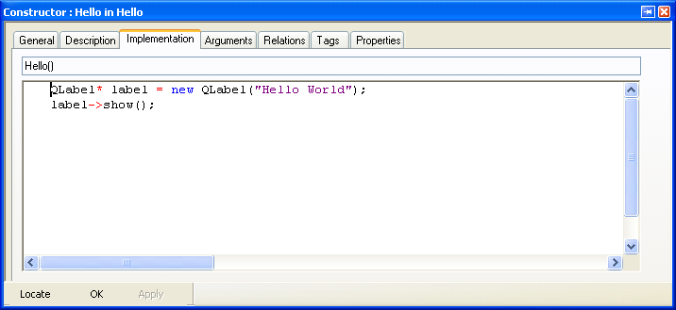
Create the Default Constructor
Add the default constructor to the Hello class, with no arguments.
Write the following implementation code:

Slide 12
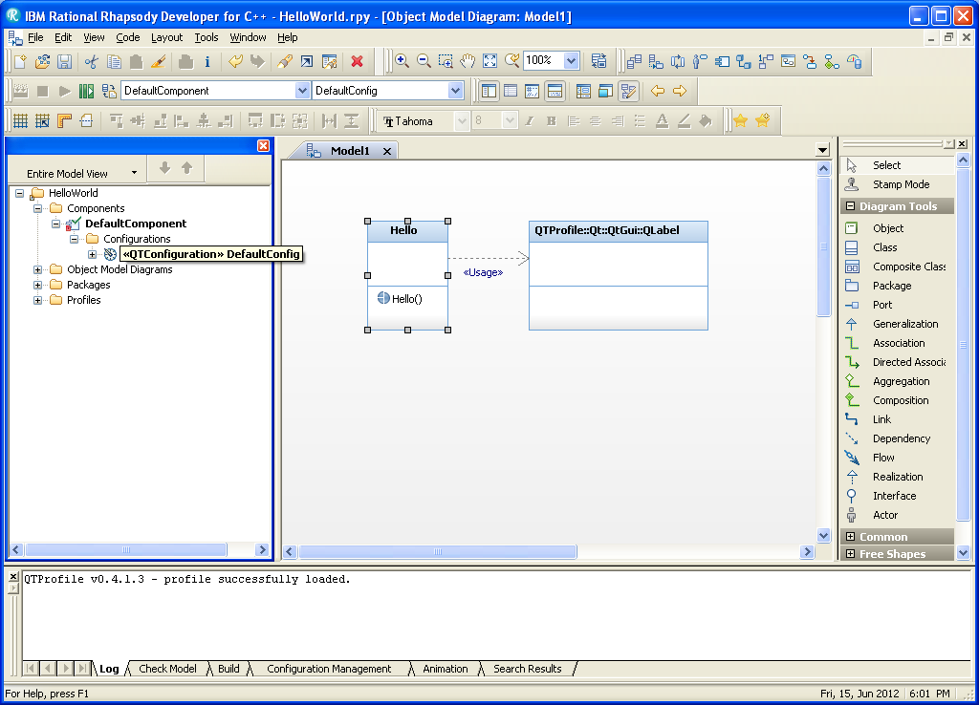
Apply the <<QTConfiguration>> stereotype to the DefaultConfig
Right-click the DefaultConfig configuration and set the <<QTConfiguration>> stereotype to it:

Slide 13
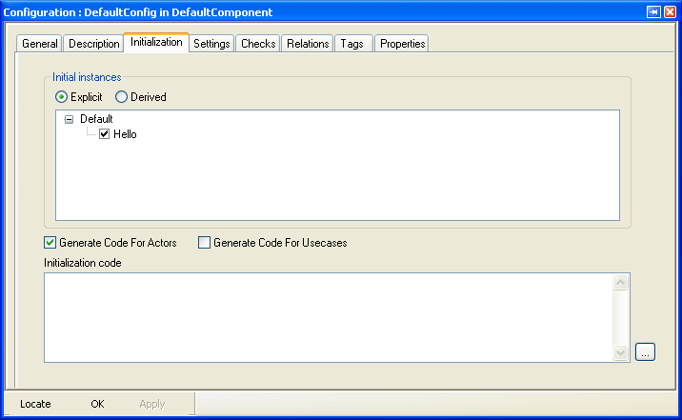
Specify the Initialiation Settings
Open the Initialization tab of the Features panel of the DefaultConfig configuration, and check the initialization check-box for the Hello class:

Slide 14
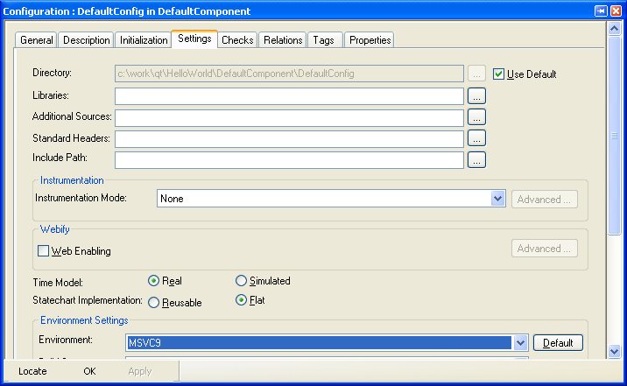
Use the Right Environment Settings
Open the Settings tab, and ensure that you are using the MSVC9 or Linux environment. You can use either Automation or None instrumentation modes.

Slide 15
Generate, Make and Run
Now you are ready to run the QT-based program:
  Save the model
  Select Generate/Make/Run
  Answer Yes to the question for generating the output directory
The Qt-based program is automatically generated, built and launched. The following window should be displayed:
Before continuing, make sure that you stop the executable. You can do this by either closing the console window or by clicking the Stop Execution button.

Slide 16
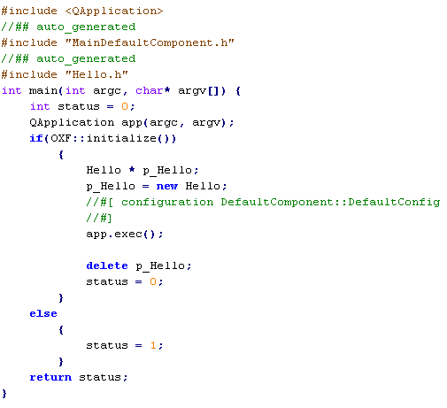
Review the Generated MainDefaultConfig class
Review the implementation of the automatically generated MainDefaultConfig class. You can notice that the profile automatically creates an instance of the QApplication class:

Slide 17
QTProfile Main Class v.s. Default Main Class (1/2)
The QTProfile introduces some differences to the generated main class, to make it compatible with Qt.
Here follows the differences:
  It automatically creates a QApplication object and starts it. This makes the main thread the Qt GUI thread too.
  It does not start the OXF main loop: if you want to use Rhapsody asynchronous events or timeout, you need at least an active class in your model.

Slide 18
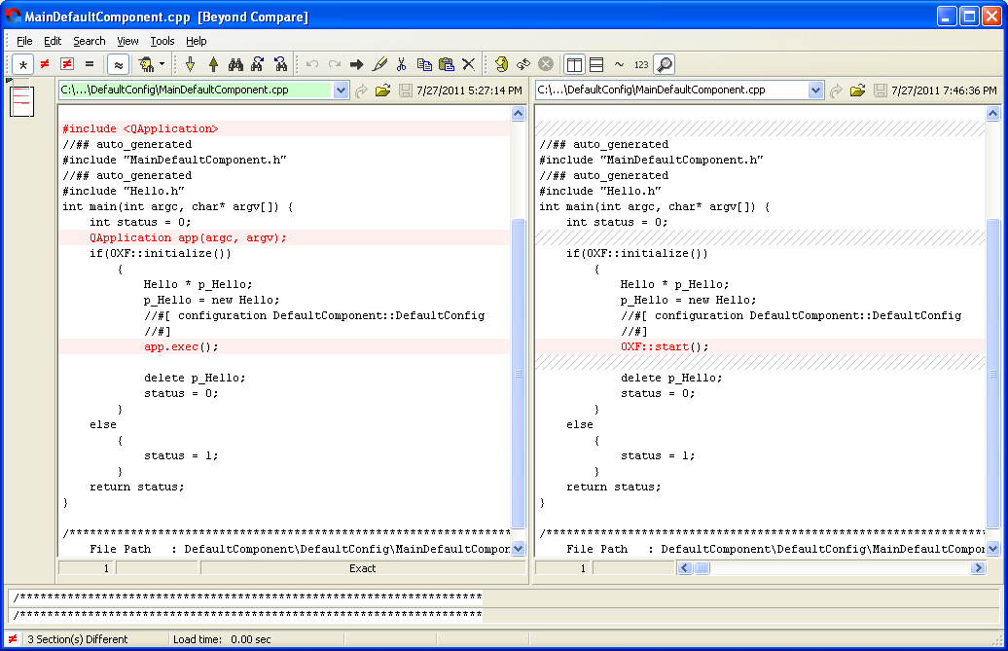
QTProfile Main Class v.s. Default Main Class (2/2)

Slide 19
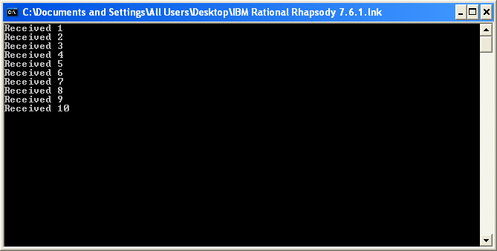
QT Signals & Slots Example

Slide 20
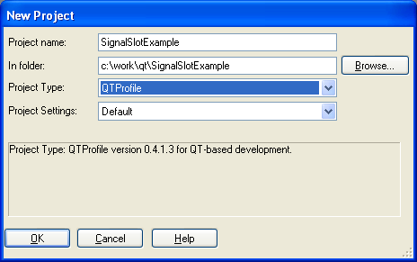
Create the SignalSlotExample Project
This is a example that shows how you can create a simple Qt application that uses Signals and Slots.
In this scenario there are two model elements that extends QObject:
  The first element, Sender, contains a <<QTSignal>> operation
  The second element, Receiver, contains a <<QTSlot>> operation
  The Main file connects Sender to Receiver and invokes the signal operation.
Create a new project called SignalSlotExample and add specify the QTProfile:

Slide 21
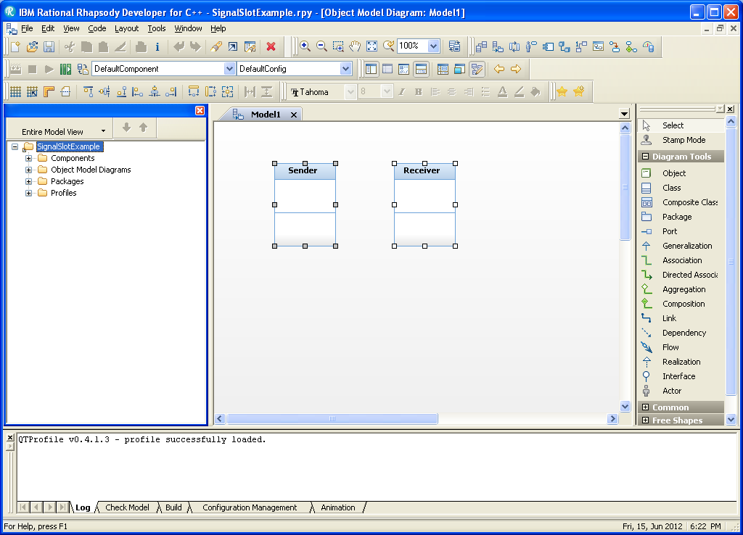
Create Sender and Receiver Classes
Create Sender and Receiver classes in the Default package:

Slide 22
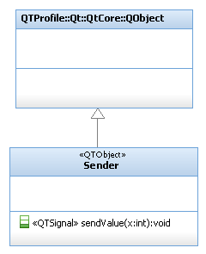
Complete the Sender Class
Add the sendValue operation to the Sender class, with an integer argument
Apply the <<QTObject>> stereotype to the Sender class
Apply the <<QTSignal>> stereotype to the sendValue operation
Create a Generalization relationship with the QObject class provided in the profile

Slide 23
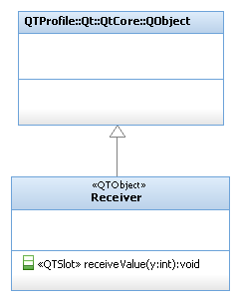
Complete the Receiver Class (1/3)
Add the receiveValue operation to the Receiver class, with an integer argument
Apply the <<QTObject>> stereotype to the Receiver class
Apply the <<QTSlot>> stereotype to the receiveValue operation
Create a Generalization relationship with the QObject class provided in the profile

Slide 24
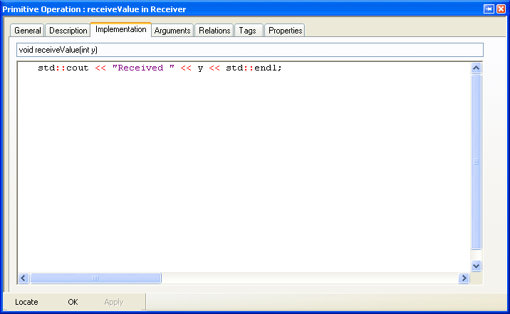
Complete the Receiver Class (2/3)
Add the following implementation for the receiveValue operation:

Slide 25
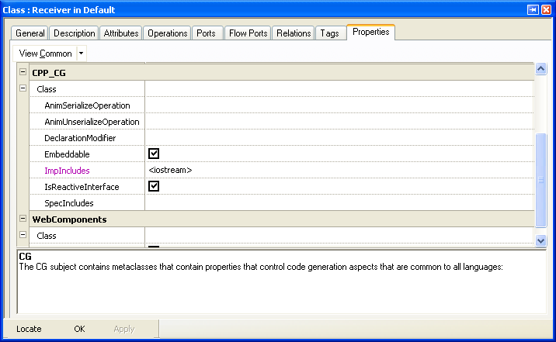
Complete the Receiver Class (3/3)
Open the Features panel of the Receiver class, select the Properties tab and set the CPP_CG::Class::ImpIncludes property as follows:

Slide 26
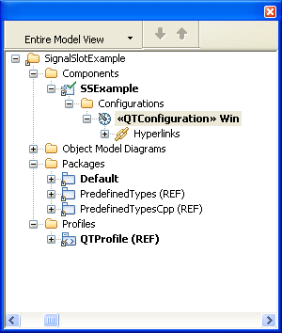
Modify Component and Configuration
Rename the DefaultComponent Component as you like (i.e. SSExample)
Rename the Default Configuration as you like (i.e. Win)
Apply the <<QTConfiguration>> stereotype to the Configuration
Ensure that the Configuration is using the correct environment, MSVC9 or Linux

Slide 27
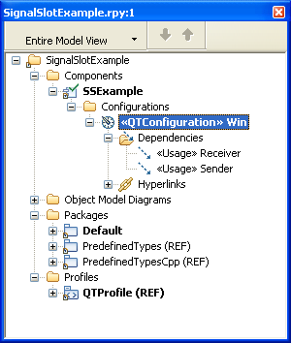
Add the <<Usage>> Dependencies to the Configuration
In order to have the include statement in the Main file for the configuration:
  Add a dependency to both Sender and Receiver classes to the Configuration
  Apply the <<Usage>> stereotype to those dependencies:

Slide 28
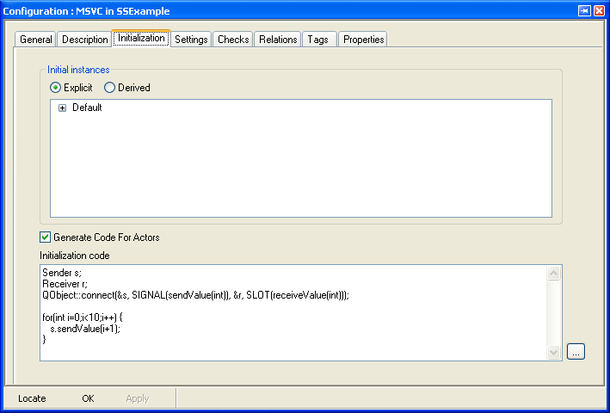
Initialization Code
Add the following code to the Initialization code portion of the Configuration:
Notes:
Sender s;
Receiver r;
QObject::connect(&s, SIGNAL(sendValue(int)), &r, SLOT(receiveValue(int)));
for(int i=0;i<10;i++) {
s.sendValue(i+1);
}

Slide 29
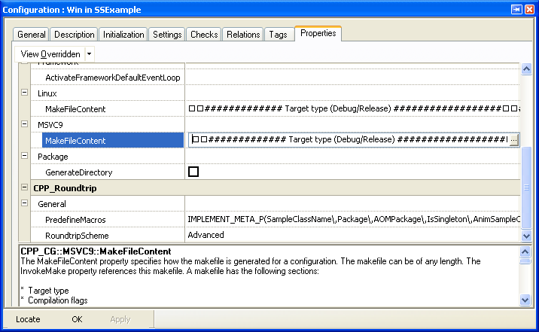
Enable Console Messages (1/2)
By default the Console is disabled. To enable it, open the Properties tab of the configuration and edit the CPP_GC::MSVC9::MakeFileContent property:

Slide 30
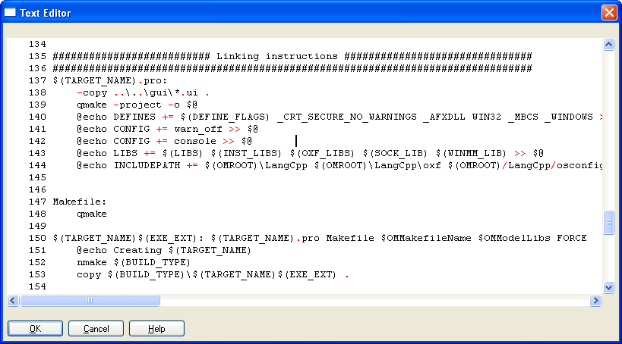
Enable Console Messages (2/2)
Add the following line to the makefile that generates the QT project:
@echo config += console >> $@
  NB: please notice that there is a tab character at the beginning of the line.

Slide 31
Generate, Make and Run
Run the application:
  Save the model
  Select Generate/Make/Run
The Qt-based program is automatically launched and the following output is expected:
Before continuing, make sure that you stop the executable.

Slide 32
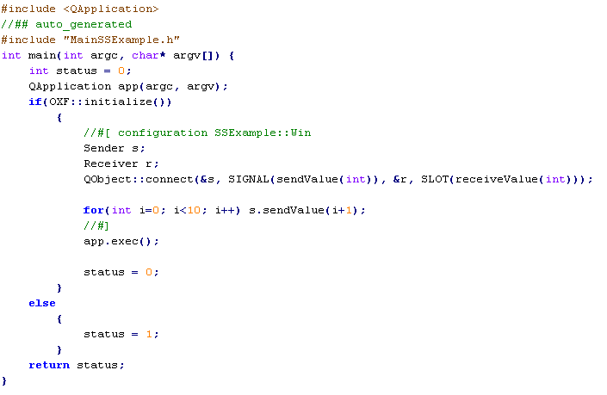
Review the Generated MainSSExample class
Review the implementation of the automatically generated MainSSExample class, generated with no OXF instrumentation:

Slide 33
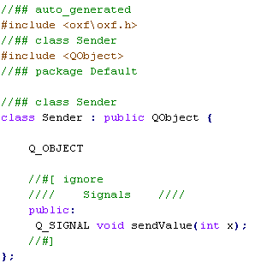
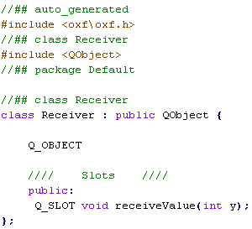
Review the Generated Sender and Receiver classes
Review the specification files of Sender and Receiver classes and see how the slot and the signal have been declared:
Notice also that the implementation for the Sender class is almost empty, as the signal is only declared in the specification file.
Sender
Receiver

Slide 34
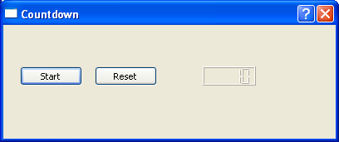
Synchronous Example : “Simple QtCountdown”

Slide 35

Create the SimpleQtCountdown Project
This is a example that shows how you can create a simple Qt-based interface for a countdown application.
In this scenario one model element is QObject and uses a synchronous Rhapsody state machines, with Triggered Operations that are Qt Signals too.
In the synchronous implementation, only the QT GUI thread runs and you have to use the QTimer class for time-based events.
Create a new project called SimpleQtCountdown and add specify the QTProfile project type:

Slide 36
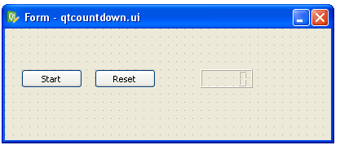
Create the Qt Panel using the Qt Designer
Using the Qt Designer, create a panel based on three graphical elements:
  a Start Button (startButton), to start the countdown
  a Reset Button (resetButton), to reset the button the initial value
  a LCD Display (lcdNumber), to show the current value of the countdown
Save the user interface file (qtcountdown.ui) anywhere in your filesystem

Slide 37
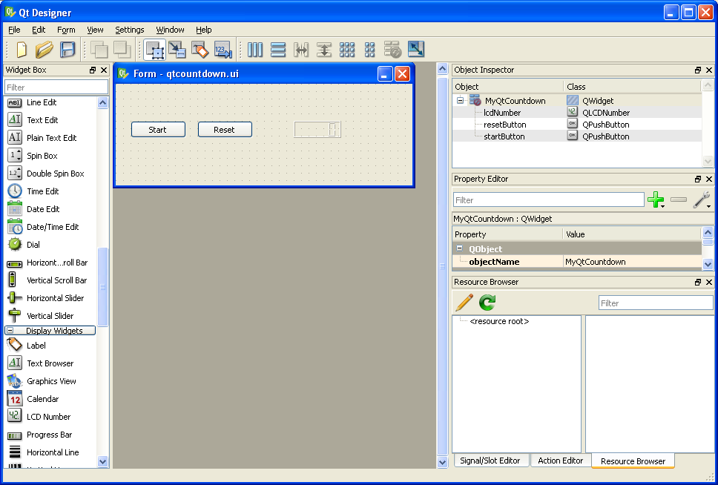
MyQtCountdown Widget in Qt Designer
Notice
these
names!

Slide 38
When Names Matter
When you define the panel definition, pay attention to the names you give:
  To the .ui file, because QT generates a .h file according to that name
    qtcountdown.ui → at build time, ui_qtcountdown.h specification file is generated
  To the graphical elements, such as the buttons and the LCD display, because you can use those names to refer to them in your code
    startButton
    resetButton
    lcdNumber
  To the QWidget you are defining, that actually represents the class to use or extend in your code
    MyQtCountdown → at build time, Ui::MyQtCountdown class is available

Slide 39
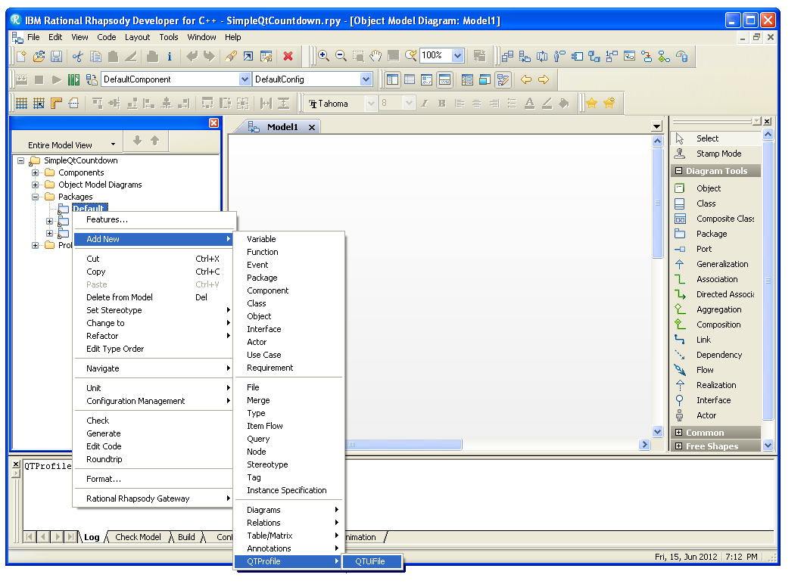
Import the Qt Widget in the Project (1/2)
Right click on the Default package and select Add New > QTProfile > QTUiFile

Slide 40
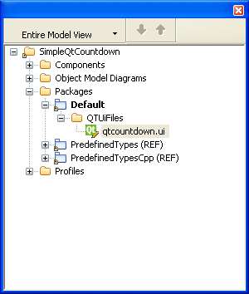
Import the Qt Widget in the Project (2/2)
In the Select QTUiFile dialog, select the .ui file you just created and press Open
Rhapsody imports the .ui file into the model, making a copy in the model tree
You can delete the original .ui file as it’s no longer need it

Slide 41
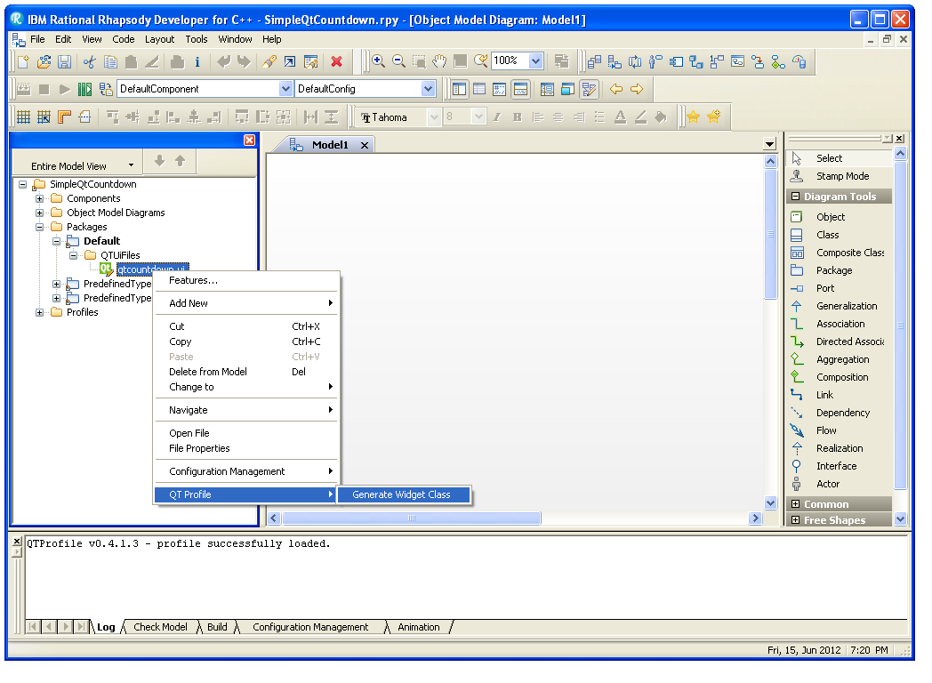
Generate the Qt Widget Class in the Project (1/2)
Right click the .ui file in the model and select QT Profile > Generate Widget Class

Slide 42
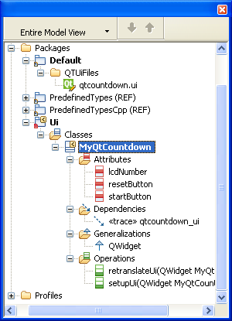
Generate the Qt Widget Class in the Project (2/2)
Rhapsody reades the .ui file and creates the Widget Class that you can refer in you model:
Notice
these
names!

Slide 43
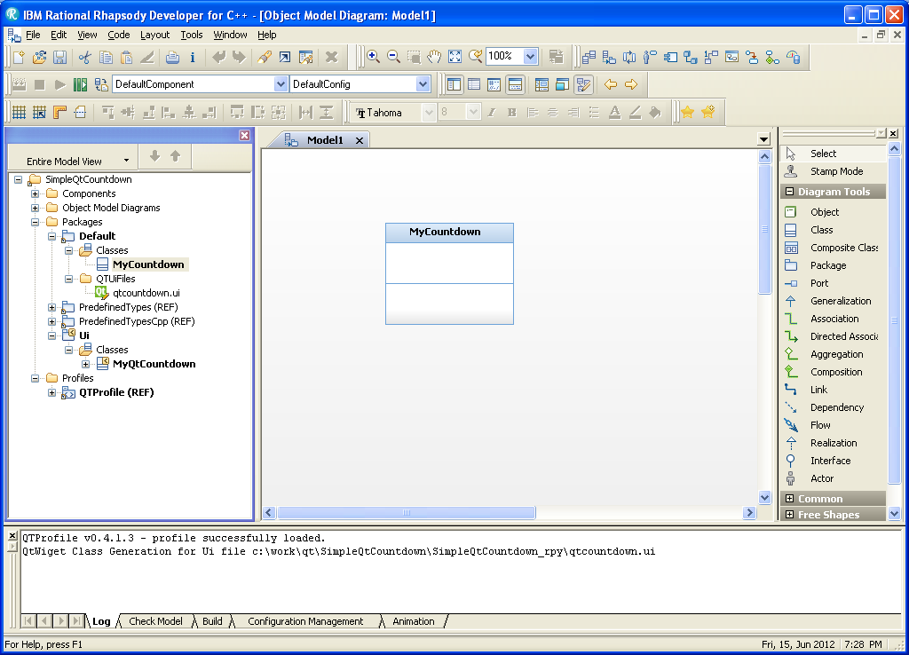
Create the MyCountdown Class
Create the MyCountdown class in the Default package:

Slide 44
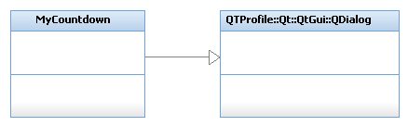
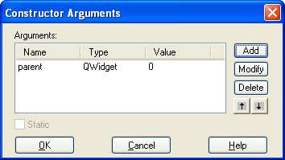
Make MyCountdown a QDialog
Drag and drop the QDialog class into the diagram from the QTProfile
Create a Generalization relationship from MyCountdown to QDialog
Create a costructor with a QWidget as parameter, ensuring that the default value is “0”:

Slide 45
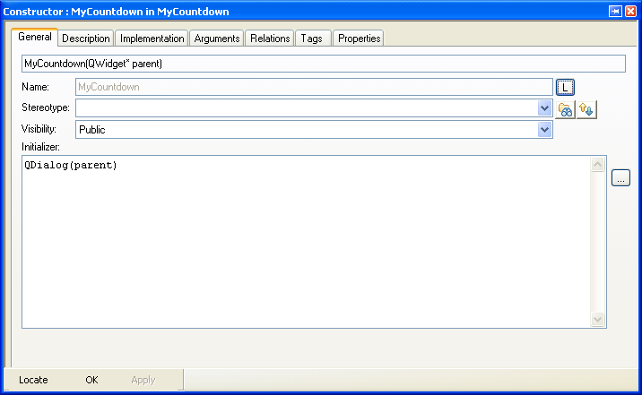
Specify the MyCountdown Constructor Initializer
Open the Features panel of the constructor and specify the Initializer text area in the General tab:

Slide 46
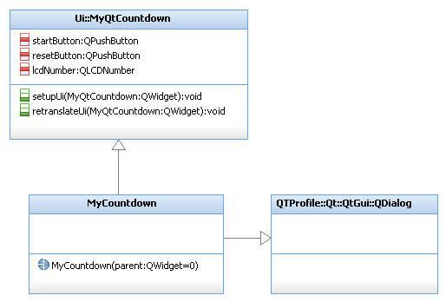
Make MyCountdown extend MyQtCountdown
Drag and drop the MyQtCountdown class into the diagram
Create a Generalization relationship from MyCountdown to MyQtCountdown

Slide 47
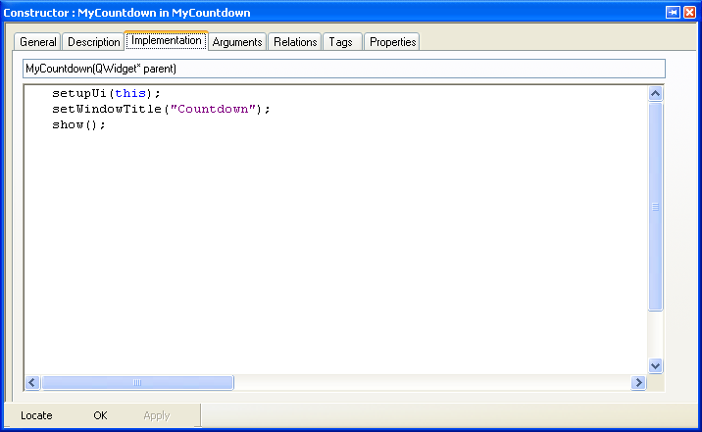
Specify the MyCountdown Constructor Implementation
Open the Features panel of the constructor and select the Implementation tab
Insert the following code to setup the widget and show it once created:

Slide 48
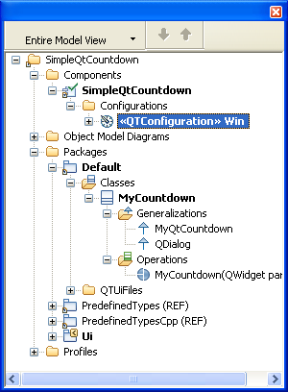
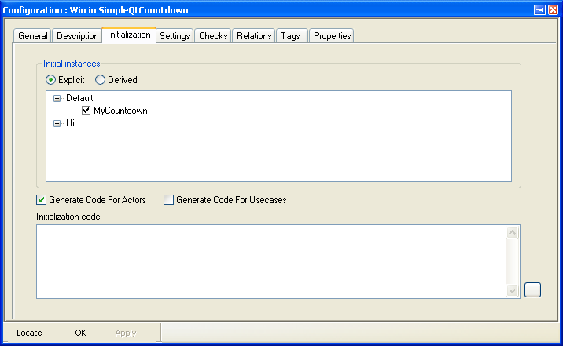
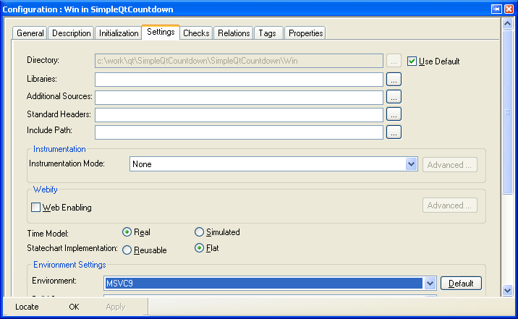
Complete Component and Configuration
Rename the DefaultComponent as SimpleQtContdown
Rename the DefaultConfig as Win
Apply the <<QTConfiguration>> stereotype to the Win configuration
Select the MyCountdown class in the Initialization tab of the configuration
Ensure that MSVC9 or Linux environment is specified in the Settings tab

Slide 49
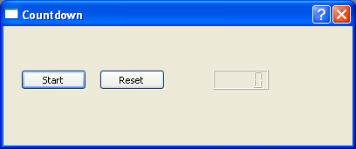
Generate, Make and Run
Before implementing any business-logic, just check that the graphical components are created correctly:
  Save the model
  Select Generate/Make/Run
The Qt-based program is automatically launched and the expected panel should be displayed:
Before continuing, make sure that you stop the executable. You can do this by either closing the console window or by clicking the Stop Execution button.

Slide 50
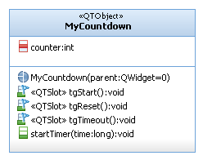
Add the Business-Logic to the MyCountdownGUI class
Add the counter integer attribute to MyCountdown class
Add the <<QObject>> stereotype to MyCountdown class
Add the following Triggered Operations to the class and apply the <<QTSlot>> stereotype to them:
  tgReset
  tgStart
  tgTimeout
Add the startTimer Operation to the class, with time as long argument.

Slide 51
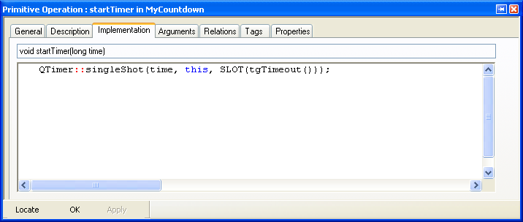
Add the Business-Logic to the MyCountdownGUI class
Create a dependency from the MyCountdown class to QTimer and specify the <<Usage>> stereotype for it.
Add the following implementation to the startTimer operation of MyCountdown:

Slide 52
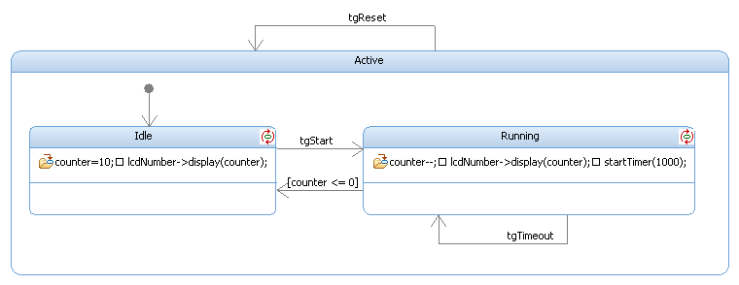
Create the Statemachine
Add the following statechart to the MyCountdown class:

Slide 53
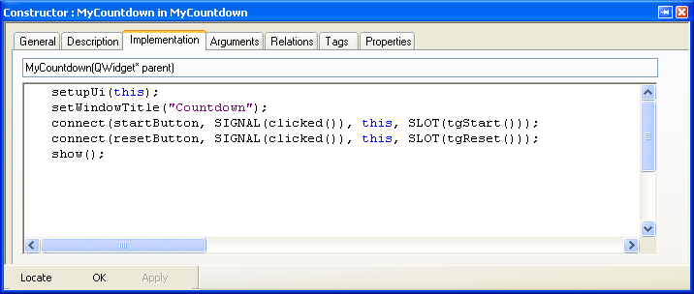
Complete the Constructor
Update the MyCountdown constructor to connect signals and slots as follows:

Slide 54
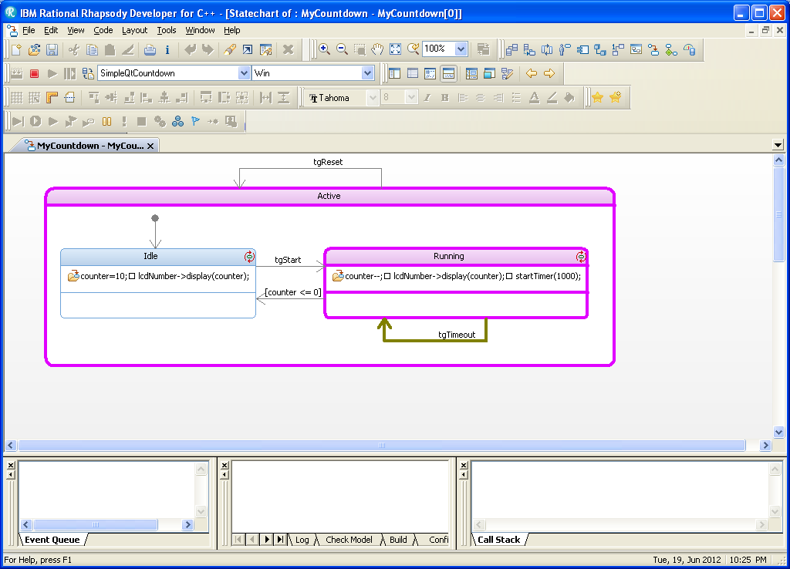

Generate, Make and Run the Application
Save the model and run the application again, and verify that the widget works as expected.
Optionally, specify the Animation instrumentation option in the configuration settings and debug the state machine:

Slide 55
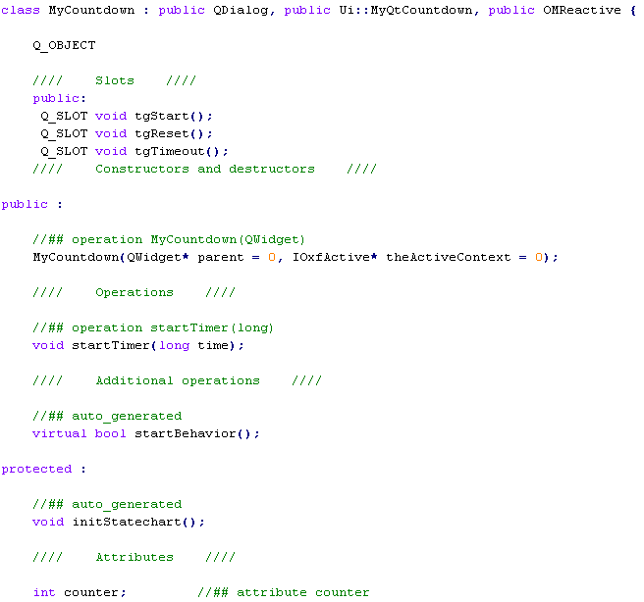
Review the Generated Code
Open the specification file of the MyCountdown class and review the code:

Slide 56
Asynchronous Example : “Simple QtCountdown”

Slide 57
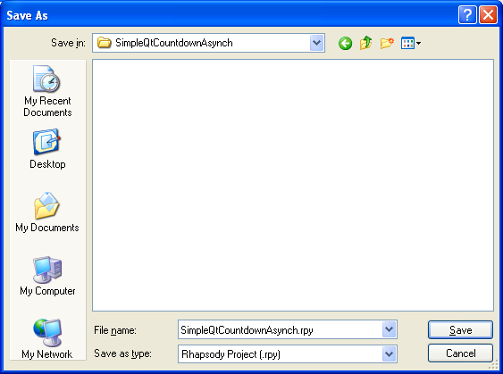
Create the SimpleQtCountdownAsynch Project
In this example, you can see how it is possible to implement the same scenario with an asynchronous statemachine, using Rhapsody Events and Receptions instead of Triggered Operations
Create a copy of the project to make these changes:
  Select the File > Save As…
  Press Press to select the work folder.
  Press to create a new folder.
  Rename New Folder to SimpleQtCountdownAsynch.
  Select the new folder SimpleQtCountdownAsynch.
  Save the project as SimpleQtCountdownAsynch.rpy

Slide 58

Make MyCountdownGUI an Active Class
When using the QTProfile, the automatically generated Main does not start the OXF Event Loop.
If you want to use an asynchronous statemachien, you need a thread that runs the OXF Event Loop and the easiest way of doing that is to make MyCountdown an Active class.
Open MyCountdown’s Features panel and select the active concurrency option in the General tab:

Slide 59

Create Asynchronous Events in the Statemachine
Open MyCountdown’s statechart and replace the two tgReset() and tgStart() Triggered Operations with two Asynchronous Event:
  evReset
  evStart
Set the <<QTSlot>> stereotype to evStart() and evReset() receptions.
Replace the tgTimeout() Triggered Operation with Rhapsody’s tm().
Remove startTimer() call in the Running action, to avoid starting the Qt Timer
Delete operations tgStart(), tgReset(), tgTimeout() and startTimer().

Slide 60

Review the Statemachine
Review the statemachine, it should look like the following:

Slide 61

Complete the MyCountdownGUI Class
Change the constructor’s implementation to connect the UI’s slots to the Receptions, that QTProfile automatically generates by adding the suffix Slot to the Reception’s name (in this example, evResetSlot() and evStartSlot())

Slide 62

Generate, Make and Run the Application
Save the model and run the application again, and verify that the widget works as expected.
Optionally, run specify the Animation instrumentation option in the configuration settings and debug the state machine:

Slide 63

Review the Generated Code
Open the specification file of the MyCountdownGUI class and review the class:

Slide 64

www.ibm.com/software/rational
© Copyright IBM Corporation 2011. All rights reserved. The information contained in these materials is provided for informational purposes only, and is provided AS IS without warranty of any kind, express or implied. IBM shall not be responsible for any damages arising out of the use of, or otherwise related to, these materials. Nothing contained in these materials is intended to, nor shall have the effect of, creating any warranties or representations from IBM or its suppliers or licensors, or altering the terms and conditions of the applicable license agreement governing the use of IBM software. References in these materials to IBM products, programs, or services do not imply that they will be available in all countries in which IBM operates. Product release dates and/or capabilities referenced in these materials may change at any time at IBM’s sole discretion based on market opportunities or other factors, and are not intended to be a commitment to future product or feature availability in any way. IBM, the IBM logo, Rational, the Rational logo, Telelogic, the Telelogic logo, and other IBM products and services are trademarks of the International Business Machines Corporation, in the United States, other countries or both. Other company, product, or service names may be trademarks or service marks of others.

